Slide 1





TuxRide Intelligence SIG

Slide 2

Installing Python
Windows:
Download Python Installer from www.python.org
Run the installer and you’re good to go!
Ubuntu:
Run the following the terminal

Slide 3
Installing OpenCV
Windows:
Run the following in Command Prompt:
Ubuntu:
Run the following in the terminal:

Slide 4
https://drive.google.com/drive/folders/14k0LBq4xgpa5Vtvpa9cuDynX-wQyE5_p?usp=sharing

Slide 5
Why Linear Regression
Linear regression is one of the most basic and popular algorithms in machine learning. When any aspiring data scientist starts off in this field, linear regression is inevitably the first algorithm they come across. It’s intuitive, has a good range of uses, and is fairly straightforward to understand.

Slide 6
What is it?
Suppose you have the dataset (Training set) of the prices of houses (Target variable) given any feature, like the size of a house or the number of rooms in the house (predictor or feature). Now your job is to predict the price of any other house, given the same feature which was given in the training dataset (like the number of rooms).
What the Linear Regression technique does is, it finds the best possible line which fits that training set and then predicts the price of any unseen house (i.e. which was not in the training set).

Slide 7
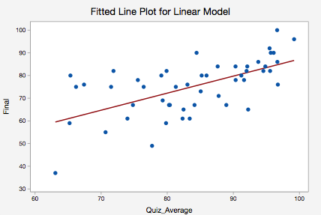

Slide 8
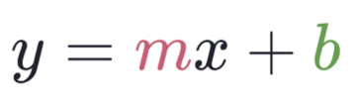
Linear Regression is a method used to define a relationship between a dependent variable (Y) and independent variable (X). Which is simply written as :
Where:
y is our dependent variable(Housing Price)
X is our independent variable(Size of House)
M is scale factor
b- bias coefficient
The goal is to draw the line of best fit between X and Y which estimates the relationship between X and Y.

Slide 9
Convolution Neural Network
Just like any other layer, a convolutional layer receives input, transforms the input in some way, and then outputs the transformed input to the next layer. The inputs to convolutional layers are called input channels, and the outputs are called output channels.
With a convolutional layer, the transformation that occurs is called a convolution operation.

Slide 10
Blue (bottom) - Input channel
Shaded (on top of blue)- 3x3 filter
Green (top) - Output channel
The filter slides over the input channel performs “convolution” operation and results in an output layer. This green channel becomes input to the next layer.

Slide 11
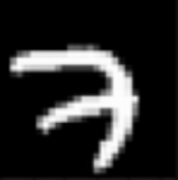
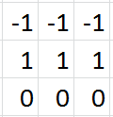
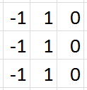
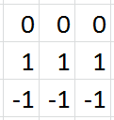
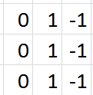

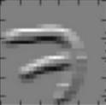
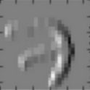
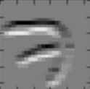
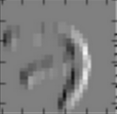
Consider this grayscale image (single color channel) of a seven from the MNIST data set is our input:
Let’s suppose that we have four 3x3 filters for our first convolutional layer, and these filters are filled with the values you see below.
If we convolve our original image of a seven with each of these four filters individually, this is what the output would look like for each filter:

Slide 12
Now let’s build our CNN model for recognizing handwritten digits!
Download the “Canvas.py” file from the drive link.
Save the downloaded file in Desktop.
Open “MNIST.ipynb” from the drive link.

Slide 13
Code Walkthrough
The first block of code imports the necessary machine learning libraries.
There are mainly 3 things going on in the second block of code:
First we load the training and test data of MNIST. The MNIST dataset consists of 60,000 training images of handwritten digits and 10,000 test images to evaluate the performance of your network.
In the next five lines under “FEATURE SCALING” The original training data has a shape of (60000,28,28). That is, 60,000 samples of 28x28 pixel images. However, our CNN model will be fed 28x28 grayscale images. And because grayscale images have only 1 channel, I reshape the data to (60000,28,28,1).

Slide 14
Contd…
A very important step in training DL models is feature scaling.
If the feature values are too varied from the initial random weight values assigned to the nodes in the layers, gradient descent will make bigger steps and we may not find the global minimum point.
Grayscale images store pixel values between 0–255. 0 for complete black, and 255 for complete white. In order to scale the features to have values within the range of 0–1, I divide each pixel value by 255. By doing so, the pixel values in the training and testing images are close enough to the randomly assigned weights at the start of training.

Slide 15
Building the model
The next few lines of code builds the MODEL.
We won’t be going into details of this, but basically we are adding layer over layer with different o/p and i/p dimensions and each layer has its own activation function.
We then compile the model, fit it on the preprocessed training data
The PREDICT function applies the same pre-processing steps to the input image, and asks the network to predict a digit for the image.

Slide 16
Lets test our model
Open command prompt/terminal.
Type in the following commands:
cd Desktop
python canvas.py
A canvas should pop up. Follow these rules
S to Start drawing(just move your cursor on the canvas to draw)
C to clear the canvas
P to Make a prediction
Q to quit.

Slide 17
Now you must have a new file in your desktop named ‘out.npy’
Move to Google Colab run the Upload Prediction block of code and upload the out.npy file created.

Slide 25

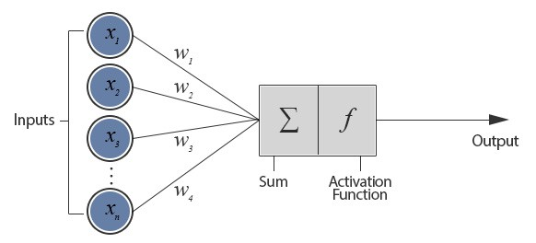
Intro to Neural Nets
Our brain uses the extremely large interconnected network of neurons for information processing. Simply put, a neuron collects inputs from other neurons. The neuron sums all the inputs and if the resulting value is greater than a threshold, it fires.
The figure depicts a neuron connected with n other neurons and thus receives n inputs (x1, x2, ….. xn). This configuration is called a Perceptron.
The inputs (x1, x2, …. xn) and weights (w1, w2, …. wn) are real numbers and can be positive or negative.

